Slide 1
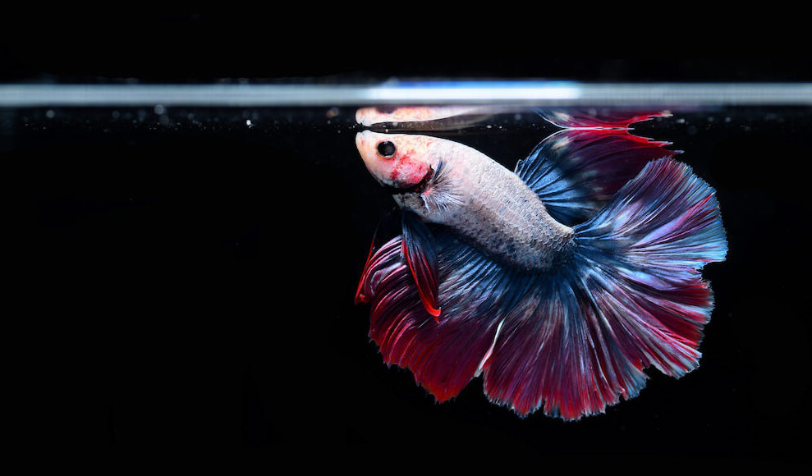
AUTOMATIC FISH FEEDER

Slide 2

Team Members:
18MIS1002 - R N Sneha Priya
18MIS1017 - Sandhiya S
18MIS1090 - Raksha S
18MIS1108 - Aishwariya Subakkar
18MIS1110 - Yuktha Sri

Slide 3
Part 1:
Abstract
Part 2:
Background
Part 3:
Why Fish Feeder?
Agenda
Part 4:
Goal of the project
Part 5:
System Architectire
Part 6:
Components
Part 7:
Working
Part 8:
Conclusion

Slide 4
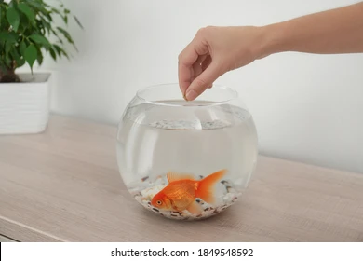
Abstract:
It is not feasible for fish owners to leave extra food in their fish’s tank before leaving for an extended period. This creates the need for a device that can automatically and reliably feed a fish. The purpose of this project is to design an automated fish feeder for household use.
The device was developed to feed a single goldfish for at least 14 days without any additional input from the user. Using an Node MCU unit to control motors, the multi-stage design feeds the fish while avoiding failures that could result in too much food being dispensed. The compact design attaches directly to the tank for easy setup.

Slide 5

Background:
Pet ownership in America has increased by 14% over the past 29 years. With 68% of households having a pet, numbering almost 85 million homes, pet ownership is at an all-time high (Pet industry market size).
According to the 2017-2018 American Pet Products Association (APPA) National Pet Owners Survey, 12.5 million homes own freshwater fish and 2.5 million homes own saltwater fish (Pet industry market size & ownership statistics.).
There are a total of 139.3 million freshwater fish owned in the United States, about one and a half times the number of dogs.

Slide 6
Why is the automatic fish feeder needed?
It is not feasible for fish owners to leave extra food in their fish’s tank before leaving for an extended period. Overfeeding fish is one of the leading causes of fish fatality.
When the food begins to break down in the tank, the proteins release ammonia, nitrites, and reduce the amount of oxygen in the water, all of which are harmful to the fish.
This can put a strain on fish owners who need to leave home and do not have a consistent pet sitter. While there are many options available for feeding cats and dogs while away from home, there are not as many choices for fish owners.

Slide 7
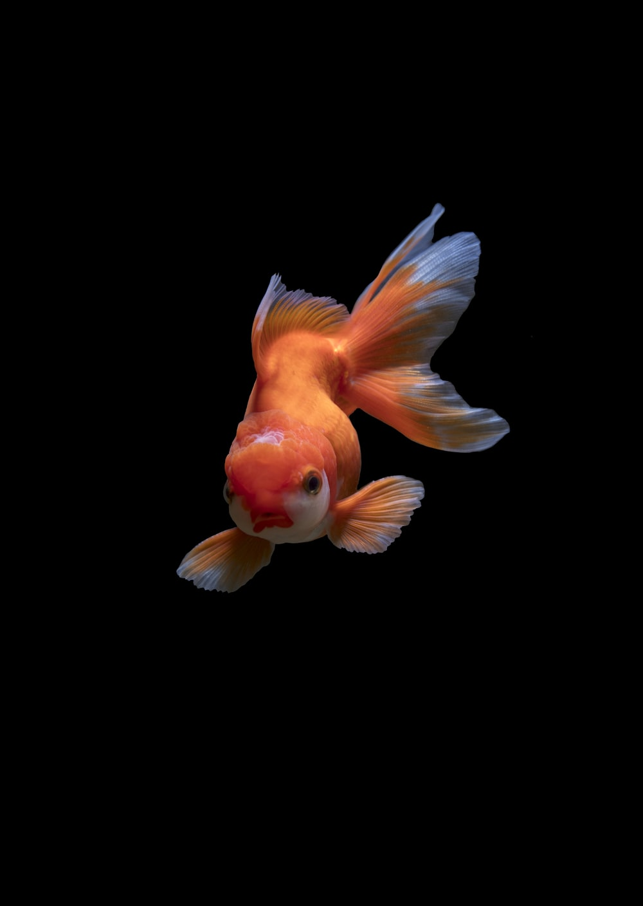
Goal of the project:
To ensure proper growth and maintenance of fish.
To design and develop automatic fish feeder for aquarium and ponds useful especially during the owner’s unavailability

Slide 8
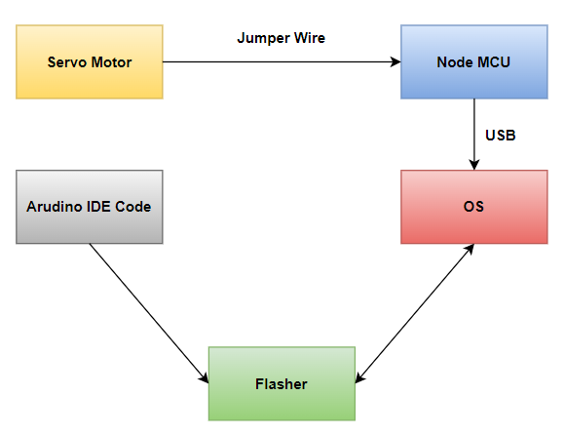
SYSTEM ARCHITECTURE

Slide 9
Components:
Node MCU
NodeMCU is an open source platform based on ESP8266 which can connect objects and let data transfer using the Wi-Fi protocol.
Why NodeMCU is better than Arduino?
NodeMCU comes with 128KB RAM and UNO it’s just 2kB RAM so NodeMCU is having more ram space.
NodeMCU is having 4MBytes of ROM (flash) and UNO is just 32 KB, NodeMCU can store more code compare to UNO.
NodeMCU comes with micro USB port and UNO is comes with USB type B connector, micro USB cable is easy available compare to USB type B.
NodeMCU development board is smaller in size compared to Arduino UNO.

Slide 10
Components:
Servo Motor:
A servomotor is a rotary actuator or linear actuator that allows for precise control of angular or linear position, velocity and acceleration. It consists of a suitable motor coupled to a sensor for position feedback.
Jump Wires:
A jump wire is an electrical wire, or group of them in a cable, with a connector or pin at each end, which is normally used to interconnect the components of a breadboard or other prototype or test circuit, internally or with other equipment or components, without soldering.

Slide 11
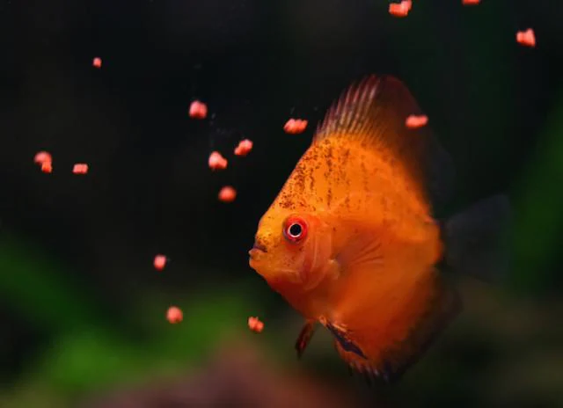
Working:
We have used funnel and normal plaste closer while automating it opens and closes based on the code written in Arduino IDE and encoded in the Node MCU
We have created a html local host page which works based on the local ip address we can feed the fish automatically using this technique

Slide 12
Conclusion:
This research is one of the alternative and easy ways to feed the fish at the right cycle time. Nowadays, the entire fish owners have to buy more equipped products which costs more to handle any kind of work dealing with the feeding fish. So this research can reduce the owner’s time and also automatically feeds the fish based on the time. The objectives of this research were successfully achieved.

Slide 13
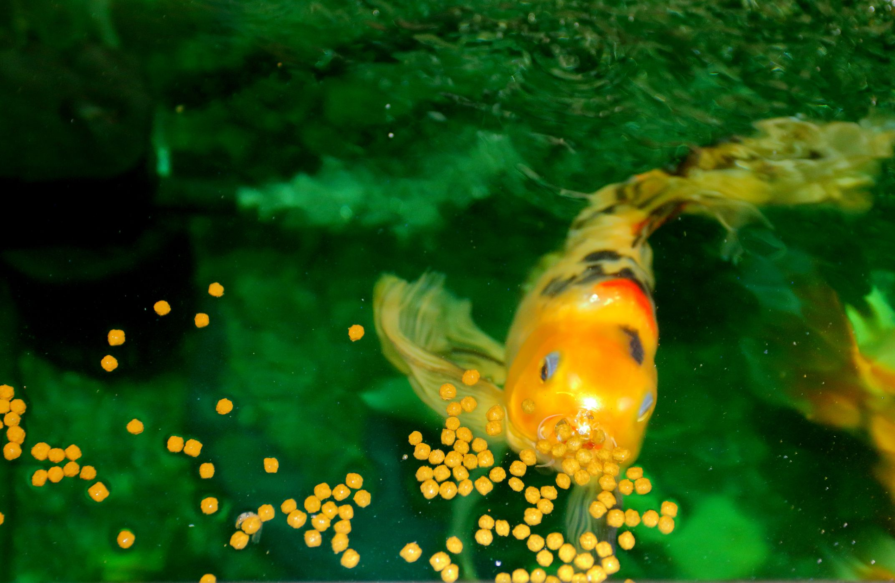
Thank you!

